Slide 1

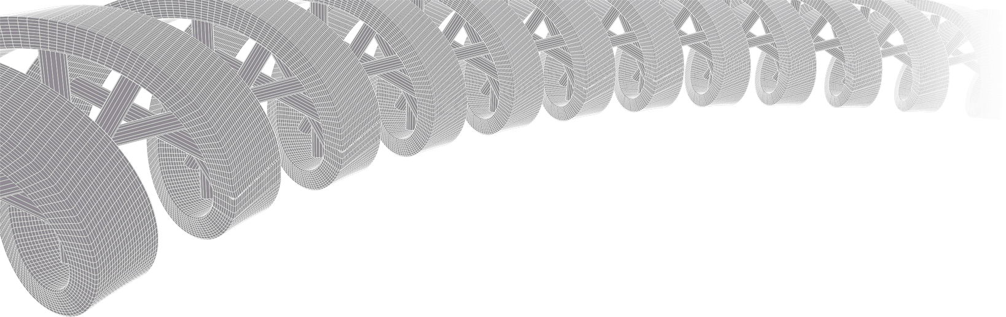
Genomic data visualization and interpretation
Malachi Griffith, Obi Griffith, Zachary Skidmore
Evomics, Workshop on Genomics
Jan 11, 2019
Český Krumlov, Czech Republic

Slide 2
Make this lecture way shorter
Focus on genomics visualizations …
Fundamental concepts of ggplot?
Principles of good visualization that are interactive with the class…

Slide 3
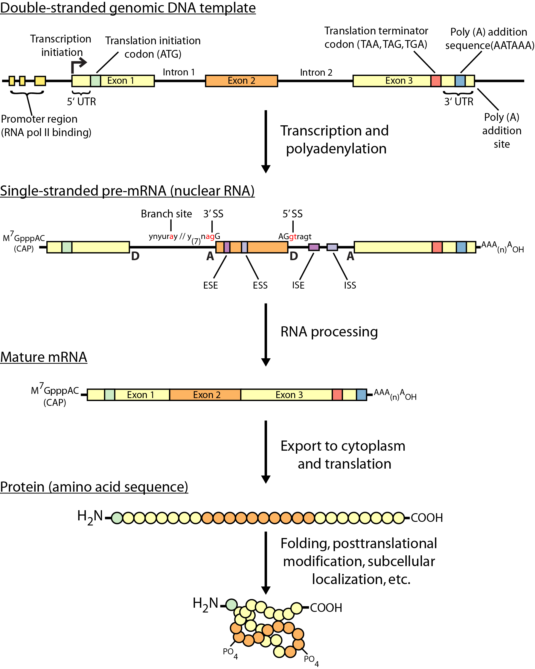
Review of central dogma

Slide 4
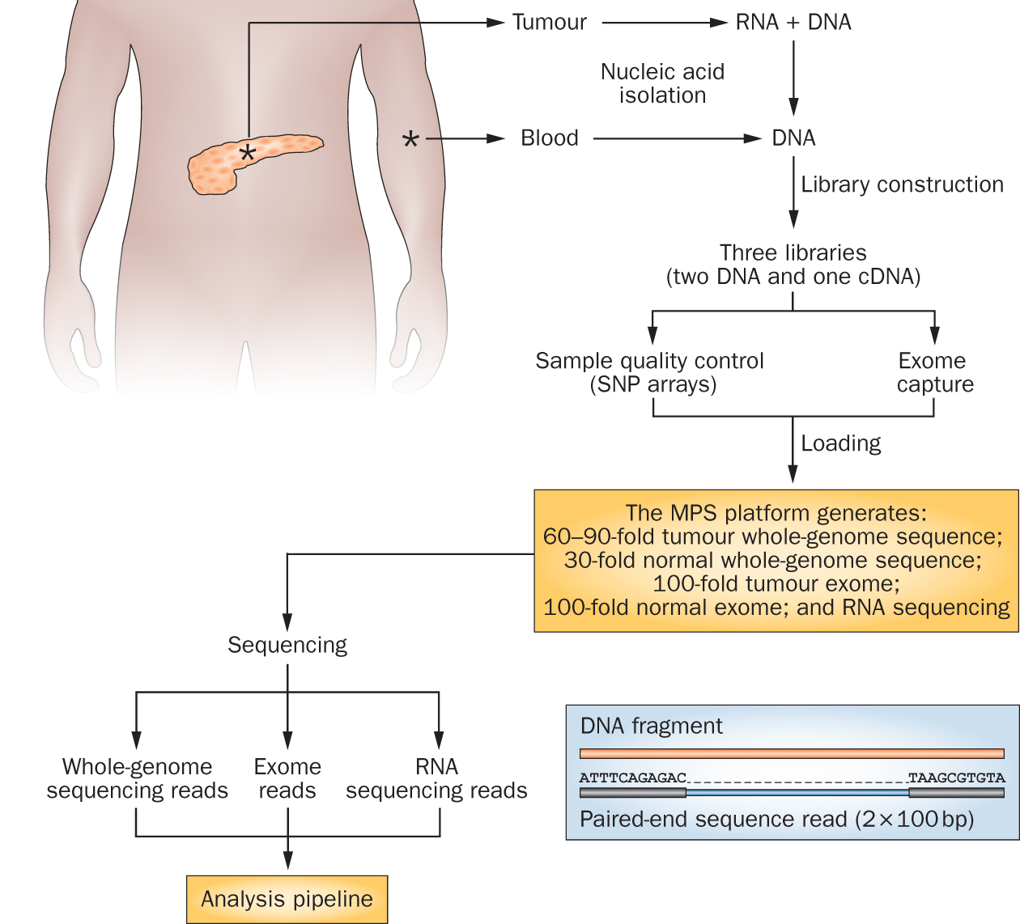
Genomics research has exploded with the rapid advances in DNA sequencing technologies
Notes:
We sequence a lot of things at the Genome Institute. But my research interest is fairly focused on clinical cancer sequencing. The idea here is that we start with a patient, sometimes starting at diagnosis but often starting at the point where they have exhausted standard of care options.
From these patients we get a tumor sample and a reference normal sample (usually blood). From the tumor we isolate DNA and RNA and from the normal we isolated DNA. This trio of samples is subjected to library construction followed by whole genome, exome, and transcriptome sequencing. This data flows into our analysis systems and we attempt to detect somatic events that might be relevant to cancer biology or treatment. This involves detecting single nucleotide variants, small insertions and deletions, large copy number amplifications and deletions, gene and isoform expression levels, structure rearrangements, expressed gene fusions, and detection of tumor associated viruses.

Slide 5
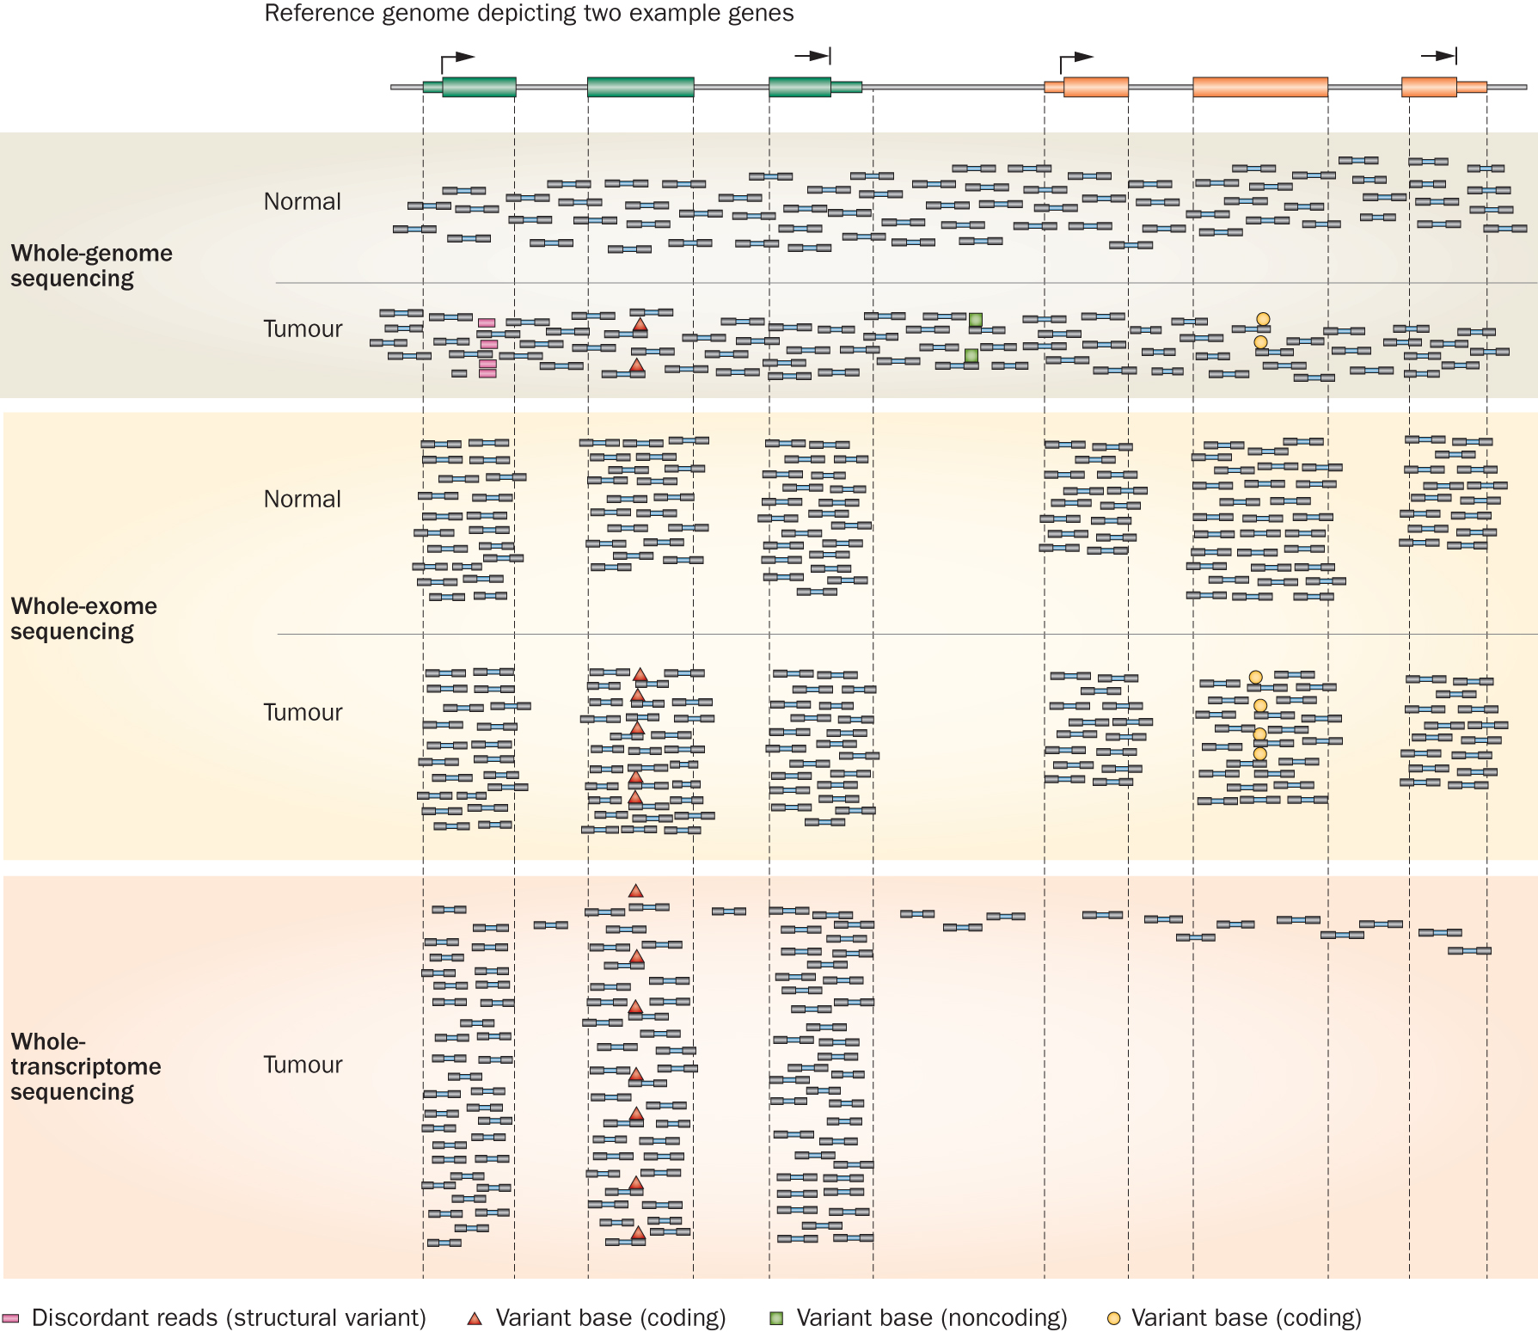
Whole genome, exome and transcriptome sequencing allows us to detect and confirm many different variant types
‘WGS’
‘Exome’
‘RNA-seq’
Notes:
Each of these three data types, whole genome, exome and transcriptome, brings something to the table.
Whole genome gives you broad, even, and relatively unbiased coverage across the genome.
Exome gives you more focused coverage but much greater depth over the exons for a much lower cost than whole genome
RNA-seq gives you a snapshot of the transcriptome.

Slide 6
Why do we create visualizations of genomic data?
Data exploration and interpretation of results
QC analysis
Understanding whether/how an experiment worked
Discovery
Communication
Slides for presentations
e.g. Keynote, Powerpoint, etc.
Figures for publications
e.g. PDFs, PNGs, etc.
Illustrator, Gimp, Inkscape, etc.
R and R Studio

Slide 7
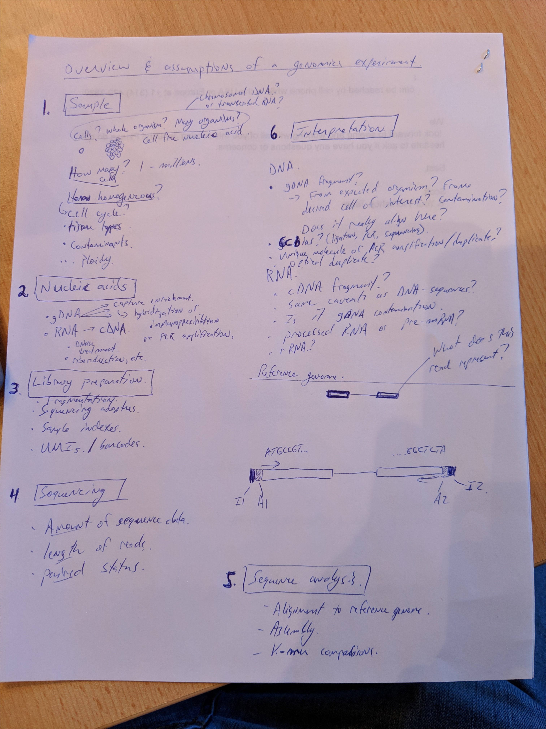
Interactive exercise on interpretation of data

Slide 8
Genome browsers

Slide 9
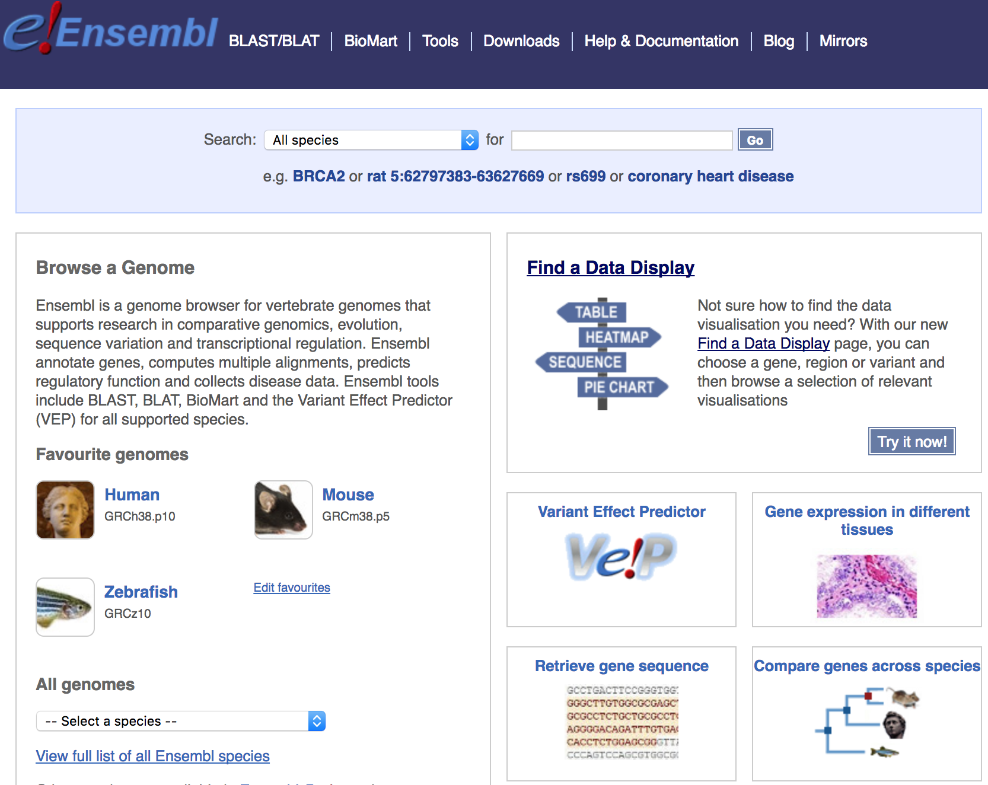
Genome browsers - Ensembl

Slide 10
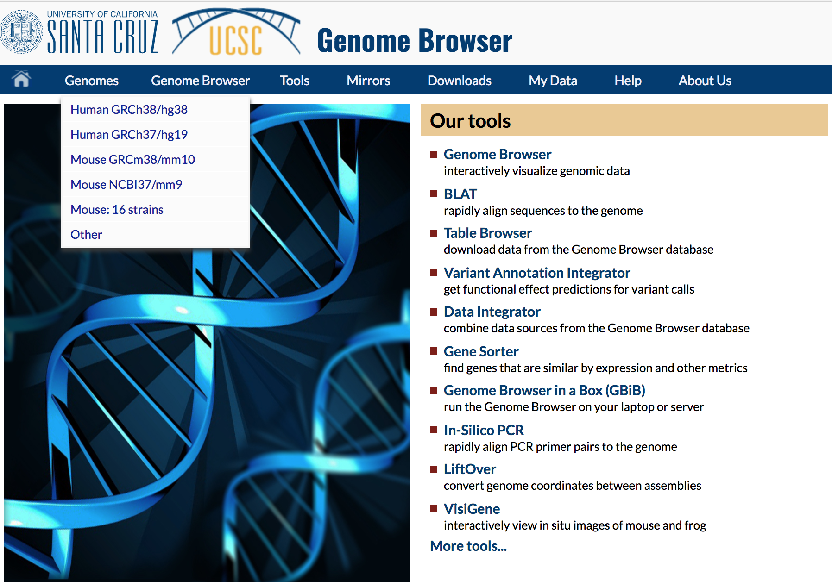
Genome browsers - UCSC

Slide 11
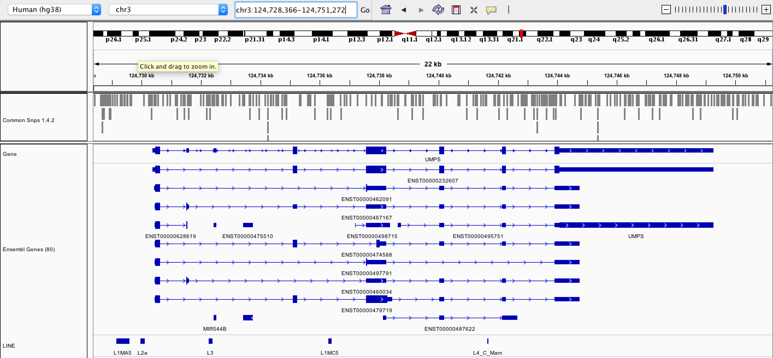
Genome browsers - IGV

Slide 12
Fundamentals of data visualization

Slide 13
Fundamentals of data visualization
Where to learn more about the art and science of visualization:
Collection of 40 Nature Methods articles on data visualization: “Points of View” Articles
Visual design principles lecture

Slide 14
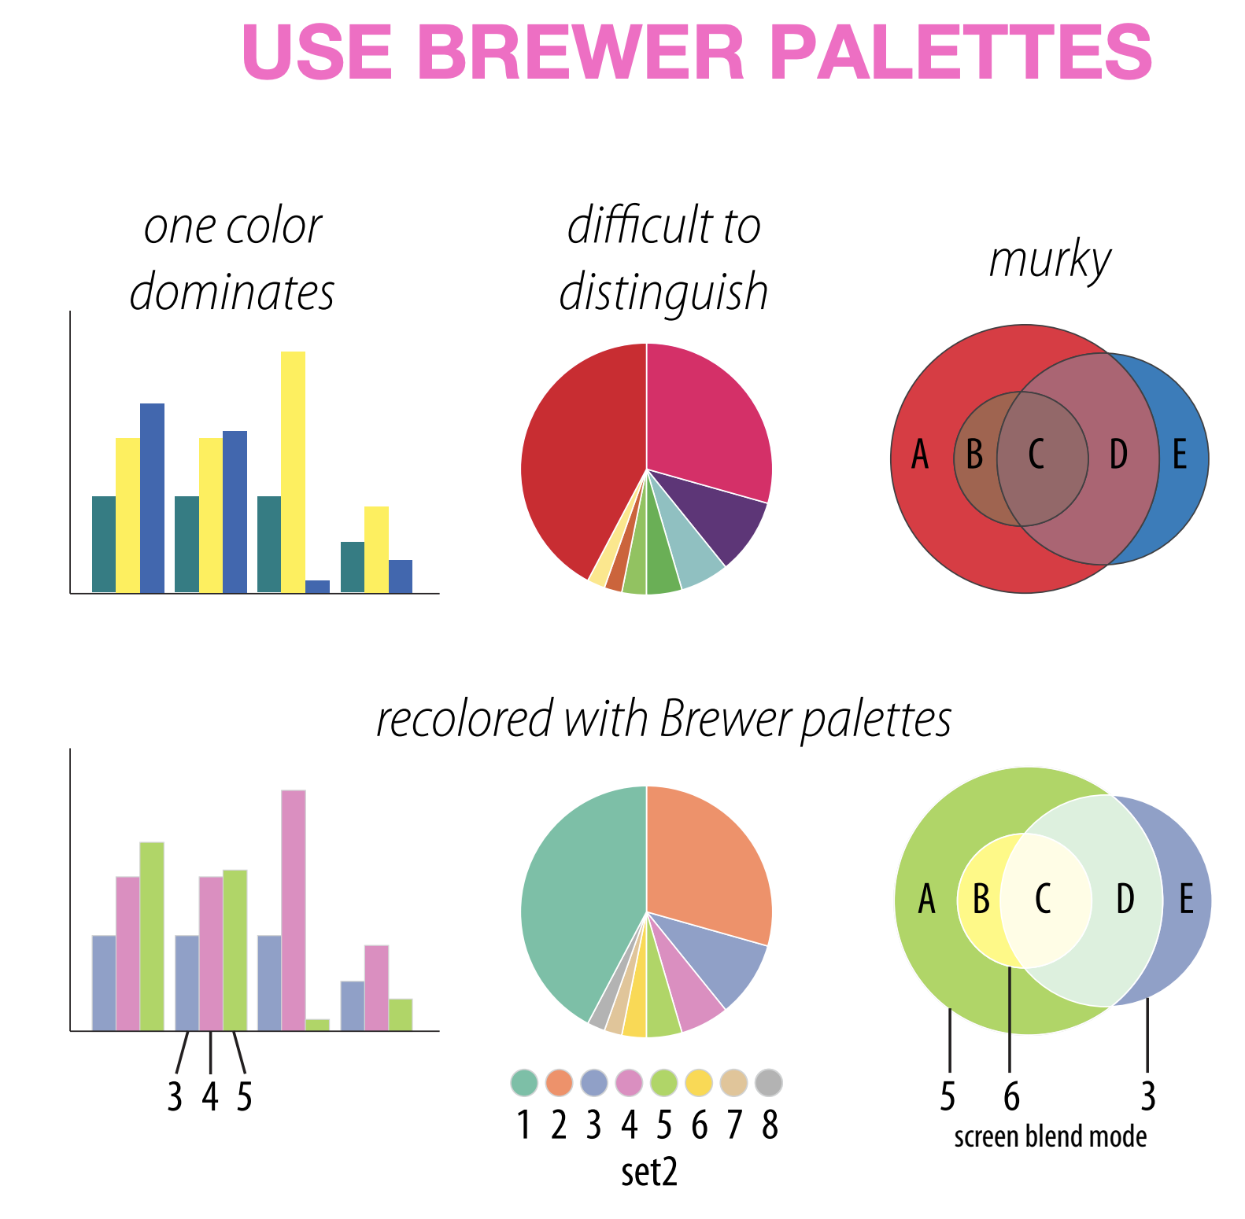
Which series is more effective (top or bottom)?
Martin Krzywinski

Slide 15
Which series is more effective (top or bottom)?
Martin Krzywinski

Slide 16
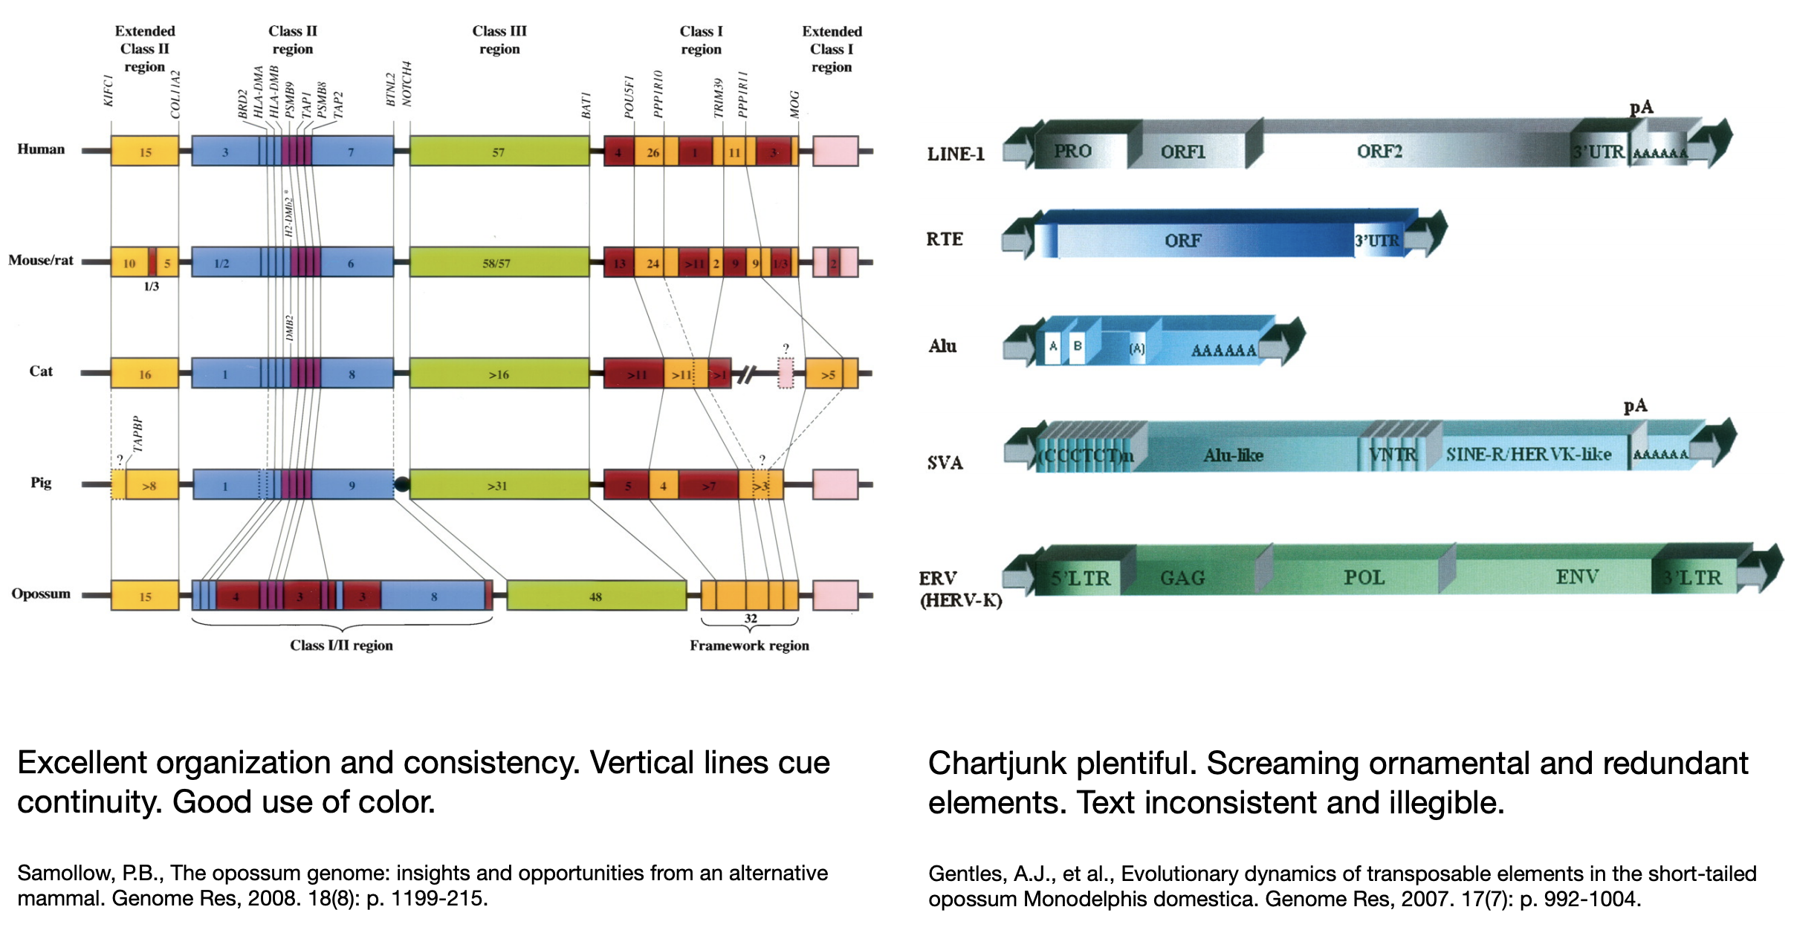
Which is more effective (left or right?)
Martin Krzywinski

Slide 17
Which is more effective (left or right?)
Martin Krzywinski

Slide 18
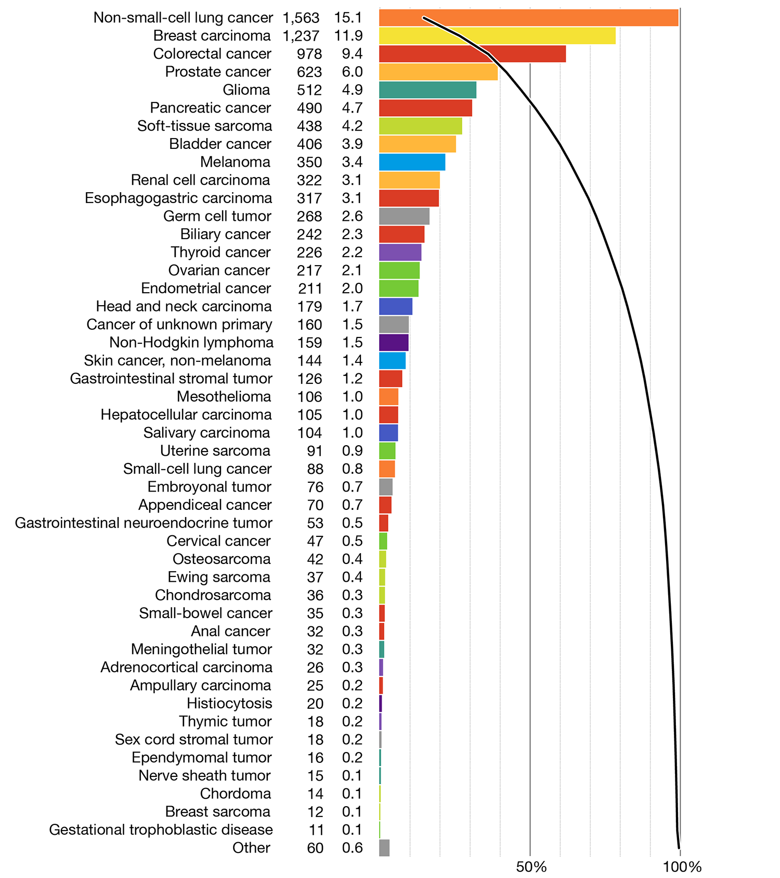
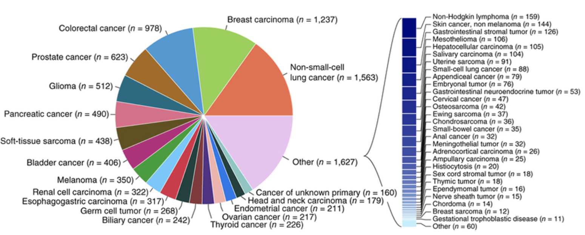
Which is more effective (left or right?)
Martin Krzywinski

Slide 19
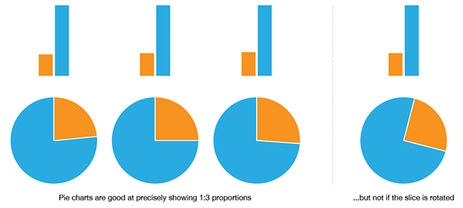
When to use a pie chart
Martin Krzywinski
Notes:
The pie chart is more intuitive than a bar plot when you have two numbers in a 1:3 proportion. Even then, it only works well when the slice is aligned. Basically if your data is more complex than this, the pie chart starts to suck pretty quickly.

Slide 20
When to not use a pie chart
Ahmet Zehir et al. (2017) Nature Medicine doi:10.1038/nm.4333
Hard to judge proportions
Poor use of color
Hard to read labels
Over ½ of the categories had to broken out of the pie chart
Martin Krzywinski

Slide 21
Same data with a redesigned approach
Martin Krzywinski
Notes:
Note the use of colors that are easy to distinguish from one another.
Now all data is displayed in the same way
Now we have bot the absolute numbers of cases, and the proportions of total listed on the left
Now we are able to show them in descending order. Instead of searching and parsing the relative size of the pie slices.
Finally, note the overlaid line that we can use to assess the cumulative proportion of all cases represented by the top N categories.

Slide 22
Selected articles on fundamentals of data viz
Visualizing samples with box plots
Circos plots
When to use (and not use) pie charts
Resources for choosing colors
http://colorbrewer2.org/
http://mkweb.bcgsc.ca/color/
Understanding and using Color Palettes
Color palettes for color blindness
Names for >9000 colors
Including 40 beer colors
Credit to Martin Krzywinski for his extensive work in this area and many of the above resources

Slide 23
Best practices in visualization

Slide 24
Best practices from this workshop
*Always* label axes
Consider readability of font size
Avoid vertical or angled text if possible
Avoid unnecessary use of color, point shapes, etc.
Chose colors wisely
If individual data points are being plotted and have started to really pile up on top of each other consider using a density function
Always be transparent about what data manipulation is taking place (e.g. log scale, filtering of outliers, etc.)

Slide 25
Best practices from the experts
Ten Simple Rules for Better Figures (Rougier et al. 2014):
Scientific visualizations should act as a “a graphical interface between people and data”. Try to follow these rules.
Know Your Audience
Identify Your Message
Adapt the Figure to the Support Medium
Captions Are Not Optional
Do Not Trust the Defaults
Use Color Effectively
Do Not Mislead the Reader
Avoid “Chartjunk”
Message Trumps Beauty
Get the Right Tool

Slide 26
Example visualizations using R

Slide 27
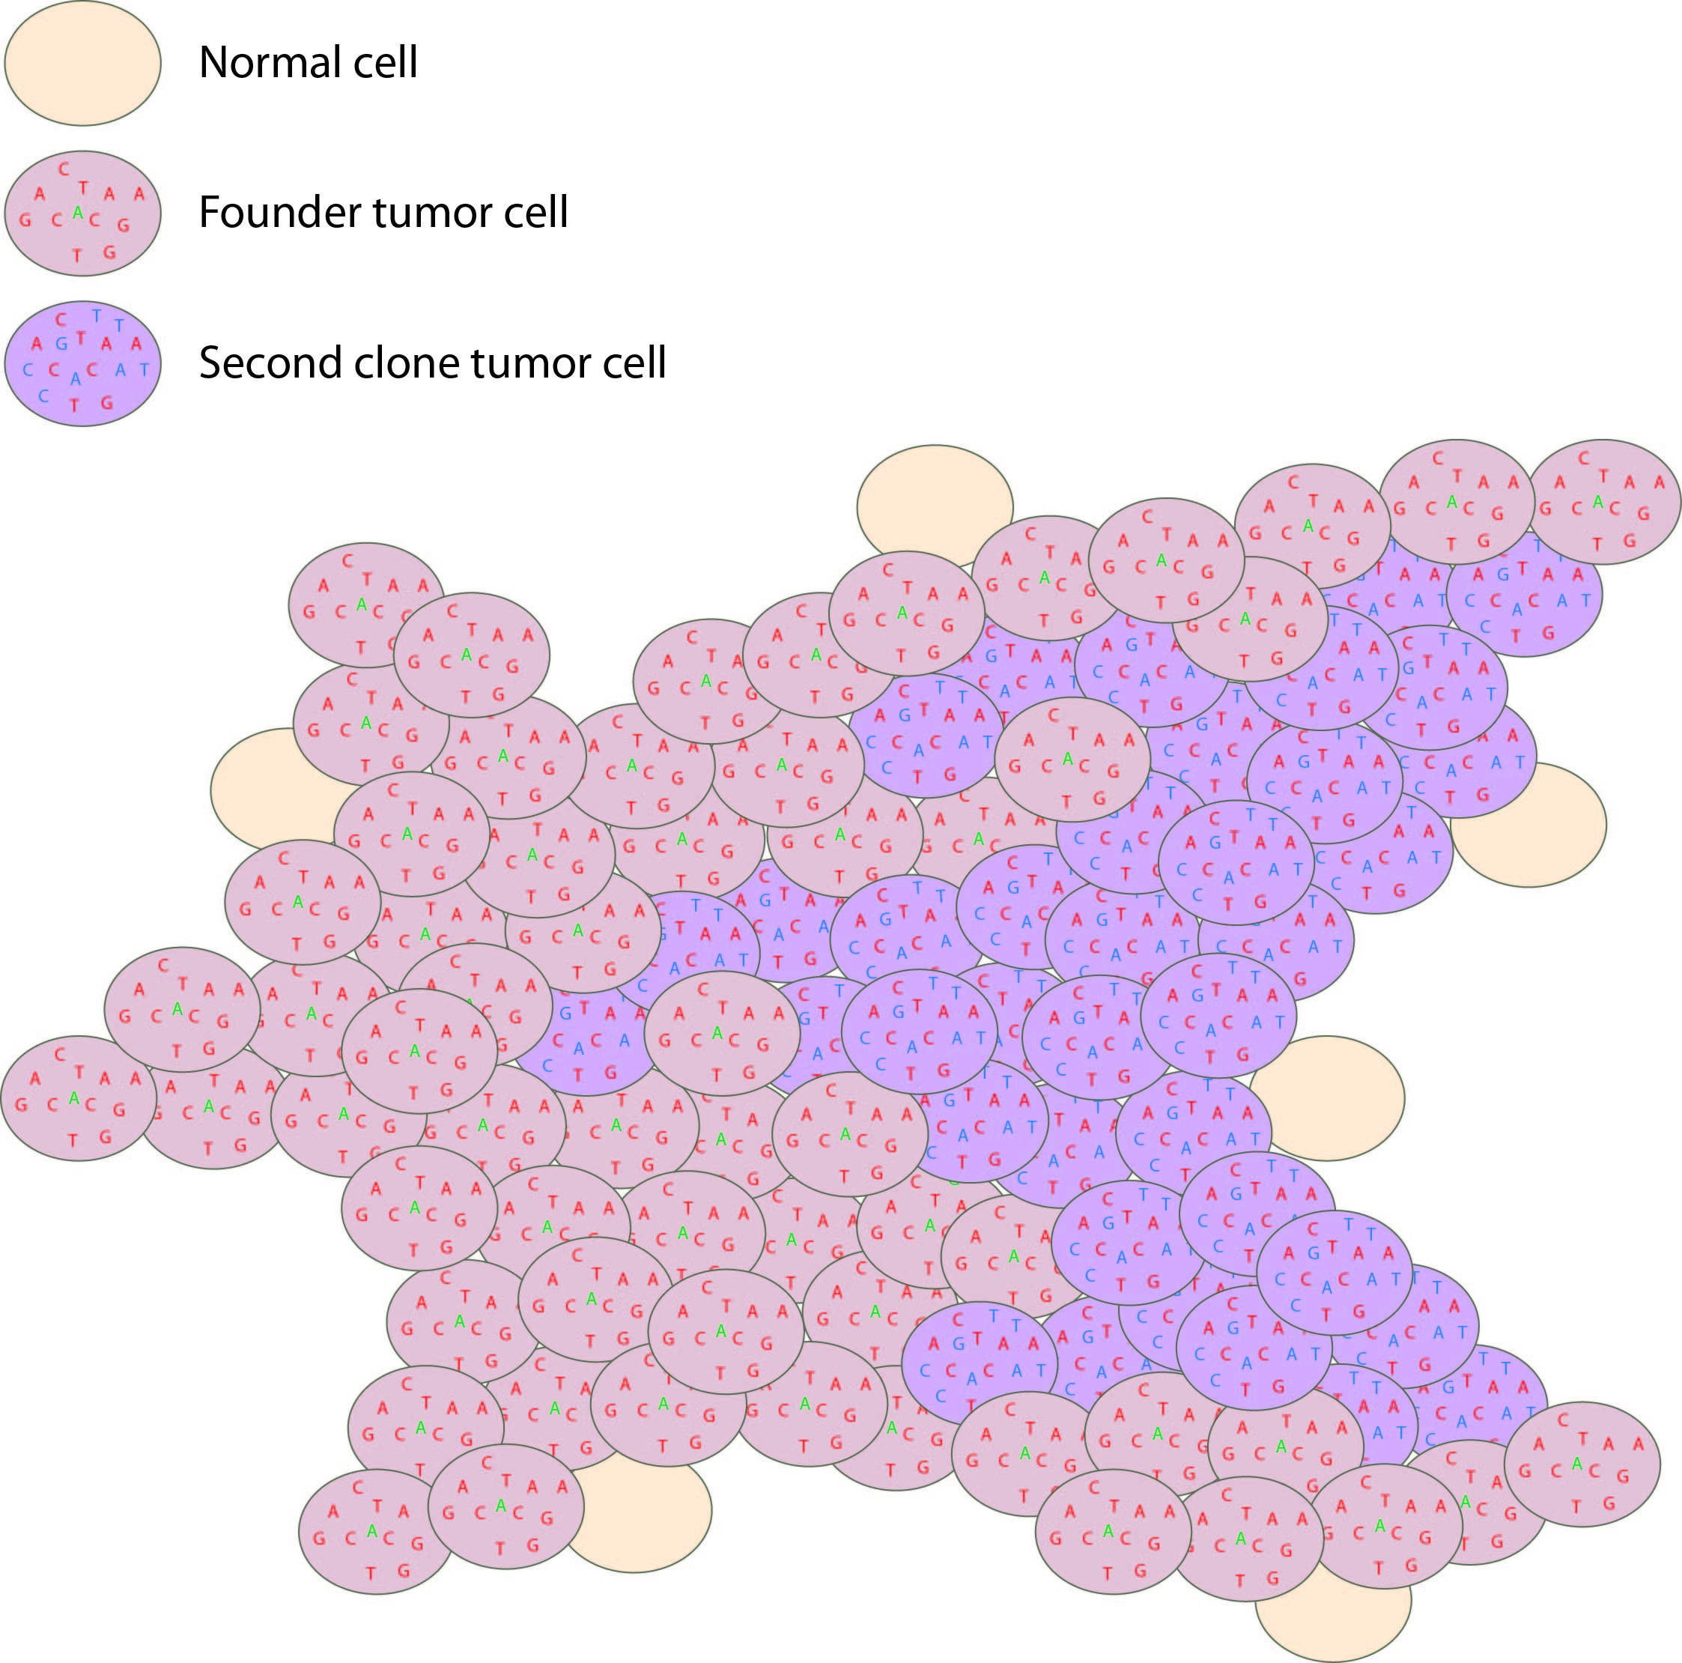
Histogram and scatterplot to define cell populations
Tumor variant allele frequency
Proportion
NF1
Read coverage (X)
WGS data
Tumor variant allele frequency
Tumor variant allele frequency

Slide 28
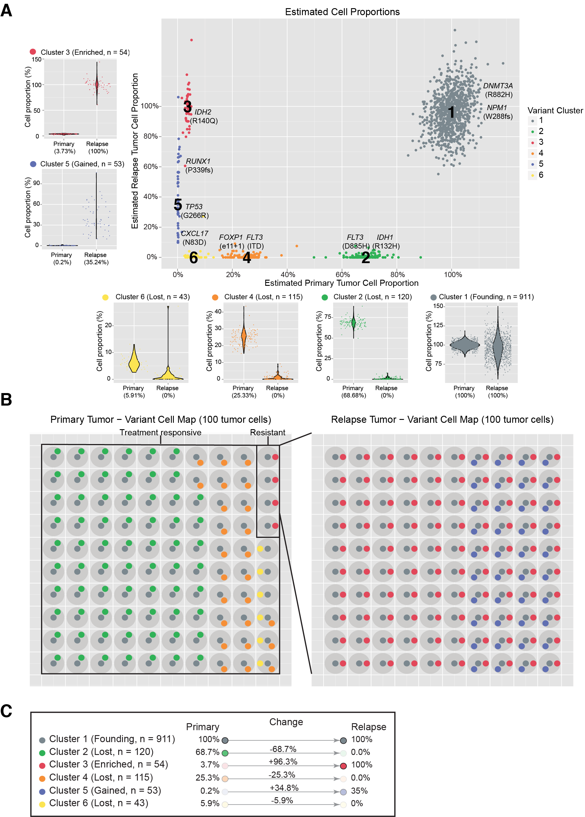
Clustering to define to distinct cell populations
Notes:
If we overlay each of these mutations on the rest of the platinum variants and use a clonality inference tools like SciClone we can resolve 6 different sub-clones, each with a couple driver mutations present. Except sub-clone 6. Based on our experiences so far we probably still haven’t sequenced deeply enough to find a driver event in that sub-clone yet.
You can see how in each of the surrounding plots, a shift in VAF distribution is occurring between primary and relapse.

Slide 29
Using a “cell map” to represent the variant clusters in 100 hypothetical cells of a tissue

Slide 30
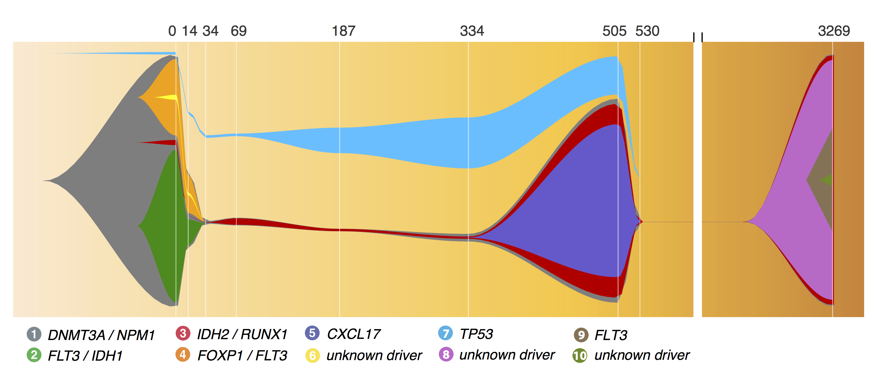
A ‘fish’ plot is used to represent sub-clones lost and gained over time

Slide 31
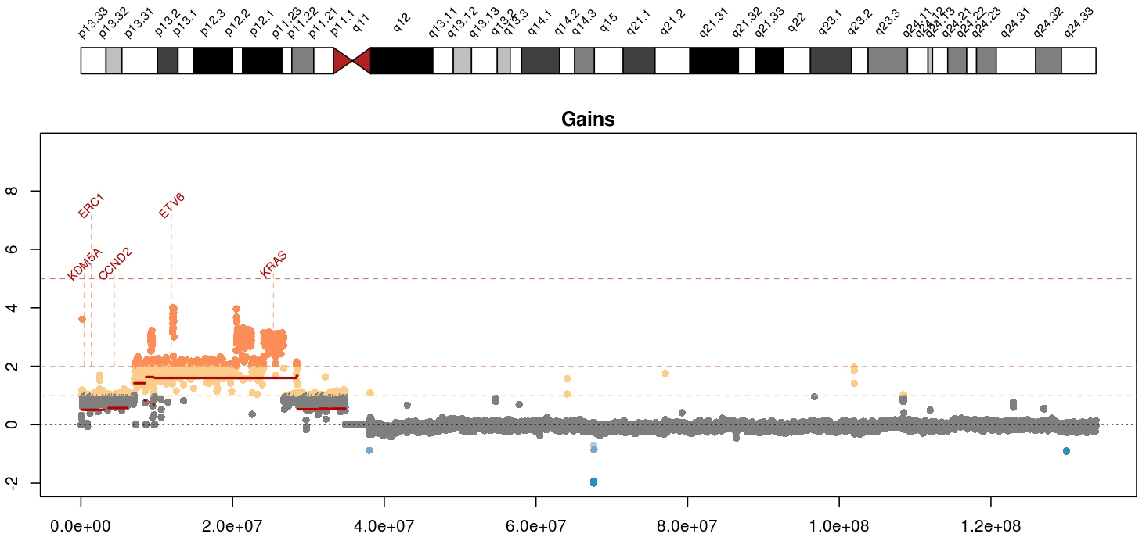
Visualizing copy number variation
Mean tumor-normal depth per 10kb window plotted
KRAS amplification in a metastatic breast cancer
Notes:
Whole genome data is exceptionally good a detecting copy number alterations in tumors. You essentially get a beautiful digital karyotype for each tumor. Here we see a complex amplification affecting KRAS and ETV6 and other critical cancer genes by both single copy and two copy gains.
We currently use cnv-hmm, CopyCat, and CnView for this kind of copy number analysis

Slide 32
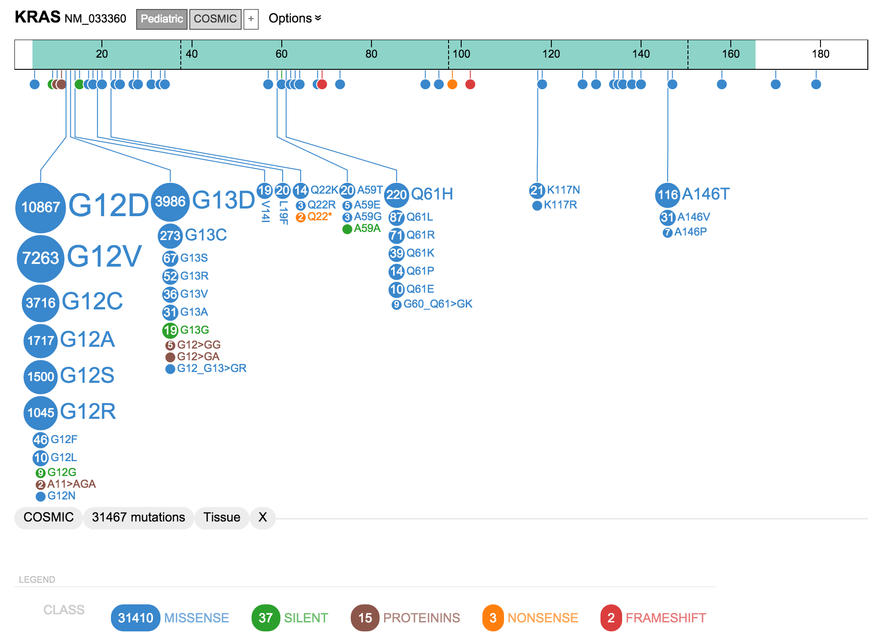
A ‘lollipop’ plot is used to variant recurrence in a gene
* Actually this one used “ProteinPaint” a web based tool

Slide 33
A ‘waterfall’ plot is one way to visualize the pattern of variant recurrence in a cohort of samples
https://github.com/griffithlab/GenVisR

Slide 34
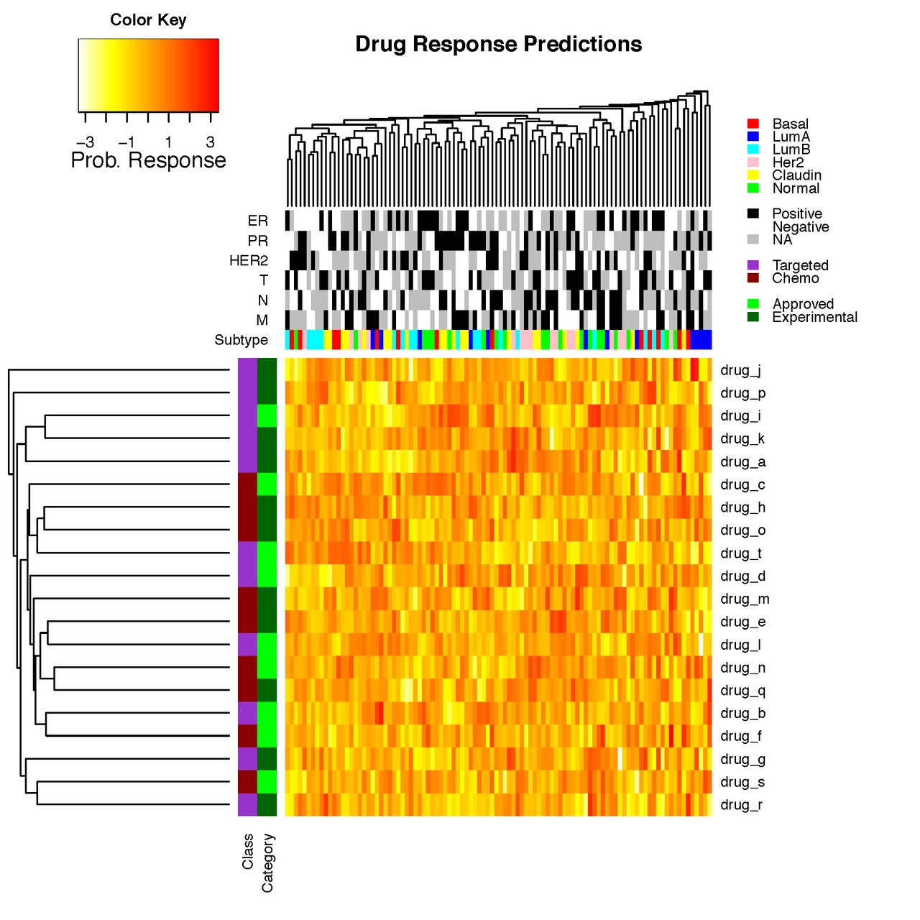
Heatmaps are a common way to simultaneously visualize multiple features of a dataset

Slide 35
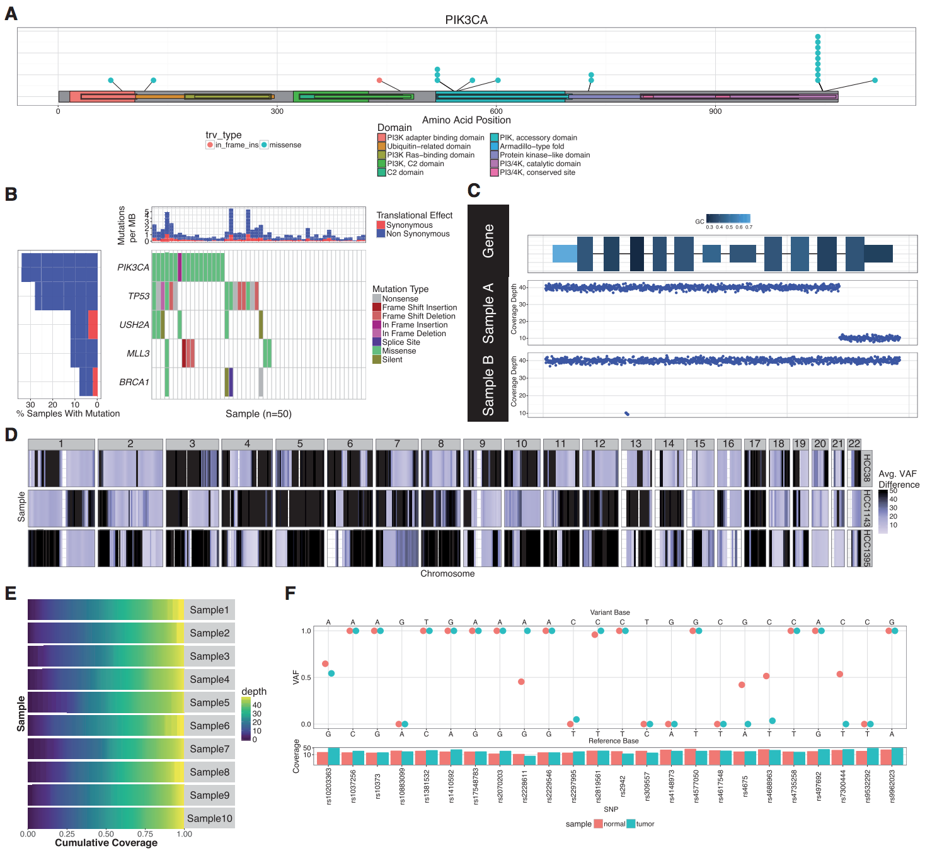
GenVisR was created to help others make common genomic visualizations

Slide 36
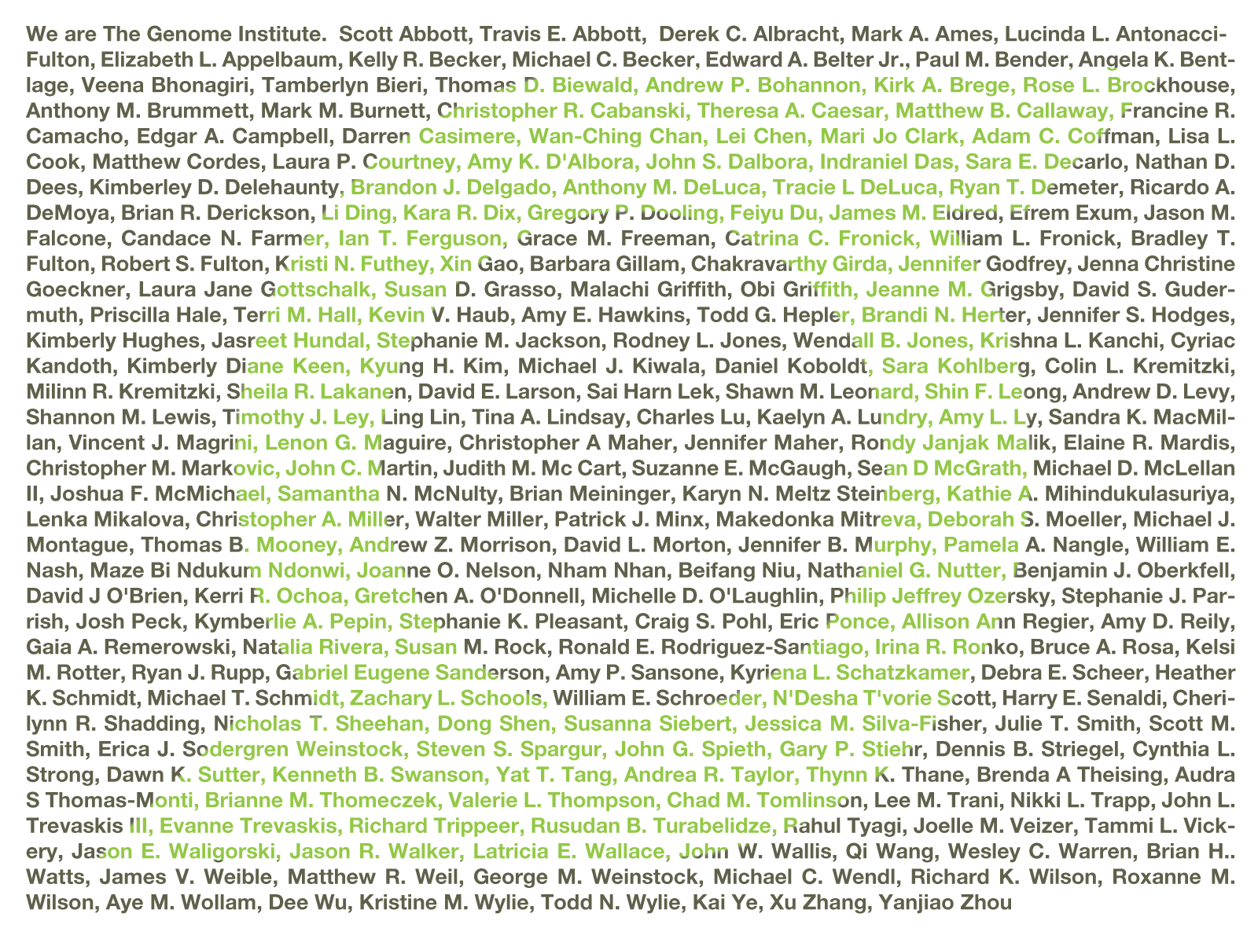
Acknowledgements: McDonnell Genome Institute
McDonnell Genome Institute @ Washington University School of Medicine
Susan Dutcher
Tim Ley
Bob Fulton
Lucinda Fulton
Ira Hall
Dave Larson
Chris Maher
Lukas Wartman
Matt Callaway
Chris Miller
Jason Walker

Slide 37
Introduction to GenViz course site
www.genviz.org

